Slide 1
GoSPA: An Energy-efficient High-performance Globally Optimized SParse Convolutional Neural Network Accelerator
2021 ACM/IEEE 48th Annual International Symposium on Computer Architecture (ISCA)

Slide 2
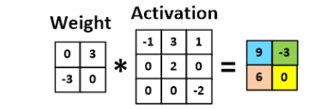
Background
Sparse Convolution Neural Network
The co-existence of activation sparsity and model sparsity in convolutional neural network (CNN) models makes sparsity-aware CNN hardware designs very attractive.

Slide 3
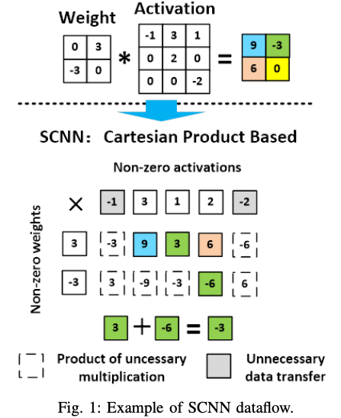
Background
SCNN:Cartesian Product Based Method
SCNN directly performs the Cartesian Product among the non-zero activations and weights.
Artificially induces multiplications among non-zero values that do not exist in the original convolution algorithm.
SCNN incurs unnecessary data transfer

Slide 4
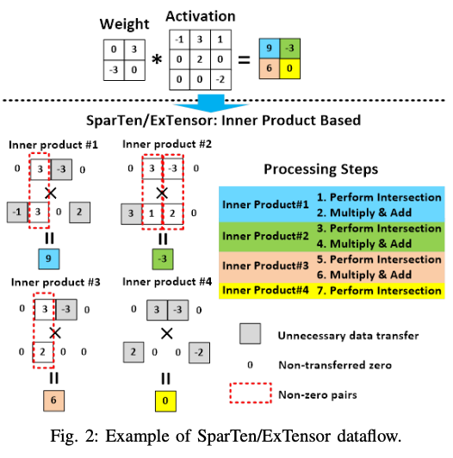
Background
SparTen and ExTensor: Intersection Based Method
Both solutions identify the matching non-zero value pairs between kernel weights and the corresponding activations with a conceptual intersection operation, then only perform the necessary multiplications between each non- zero pair.
The hardware cost of the intersection operation is high.
The latency of intersection operations is in the critical path of execution time: a computation phase always needs to wait for the corresponding intersection phase.
Unnecessary data still needs to be loaded from SRAM.

Slide 5
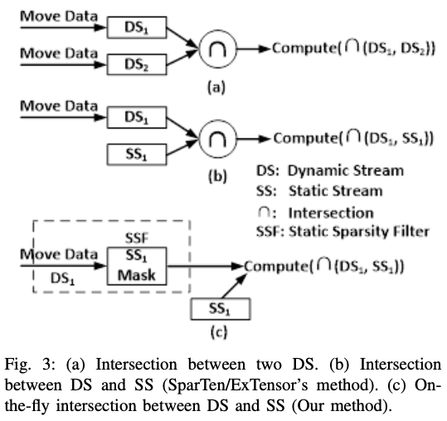
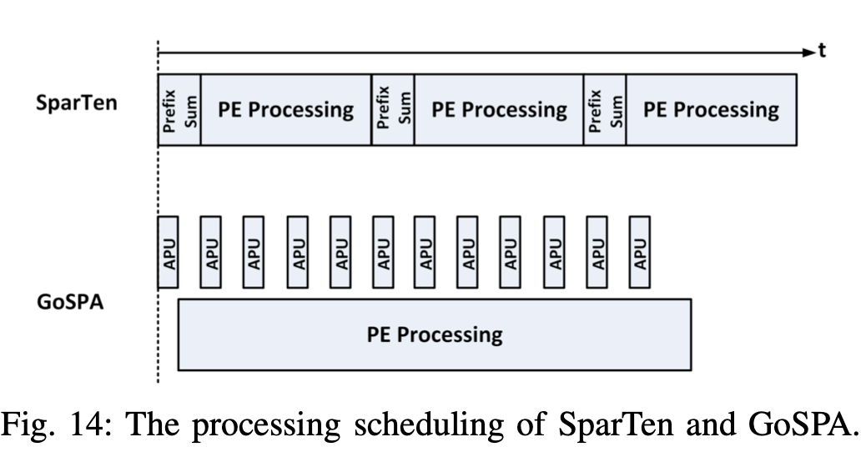
Efficient Specialized Intersection
On-The-Fly Intersection
Dynamic Stream: its data elements are not known before executing the computation
Static Stream: its data elements are determined beforehand and never change
Static Sparcity Filter: based on SS sparsity information, indicates the indices of the non-zero elements as bit mask in the static stream
Advantage: the high cost hardware structure for intersection is no longer needed; the computation does not need to frequently wait for the outcomes of intersection; avoid transferring the unnecessary activations.

Slide 6
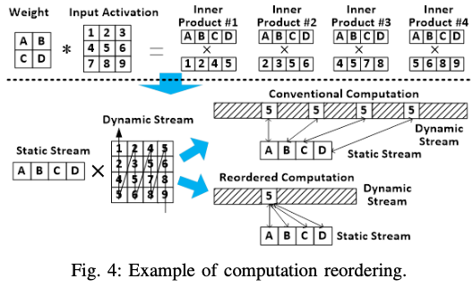
Efficient Specialized Intersection
Specialized Computation Reordering
A given element in the dynamic activation stream should be checked with all possible pairing weights together, and if both non-zero, should be sent to the corresponding compute units for multiplication. This idea can avoid the repeated data transfer of the same activation, and ensures that each activation is only transferred if necessary, and only once.
The convolution ID (CID) and position ID (PID) for each activation is needed for multiply correctly.

Slide 7
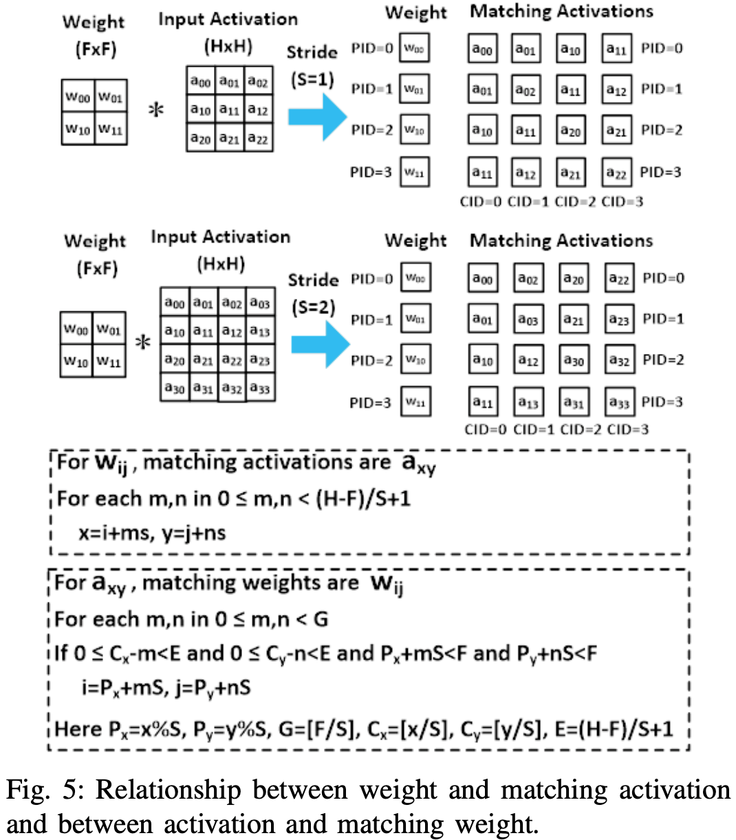
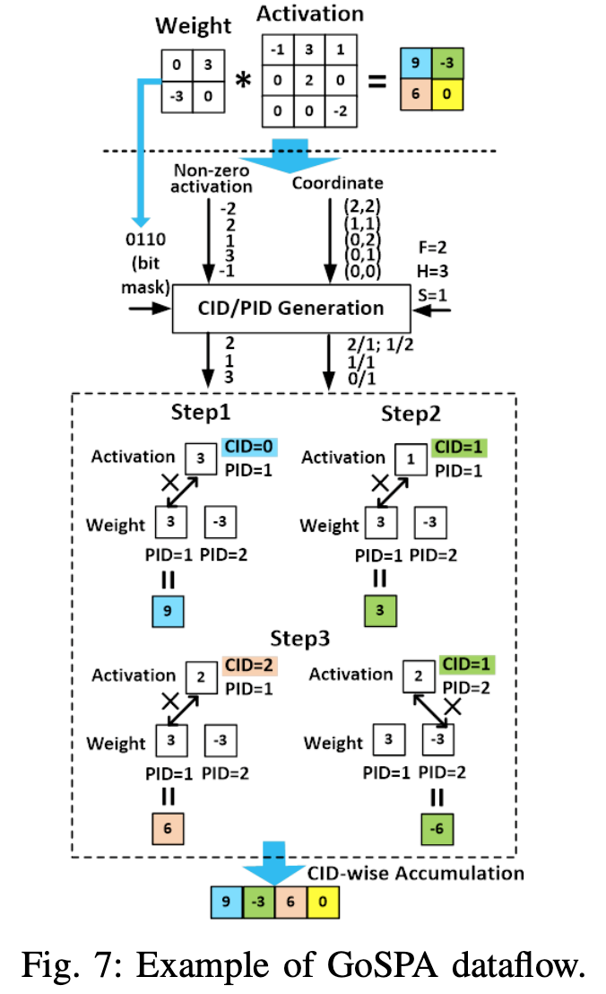
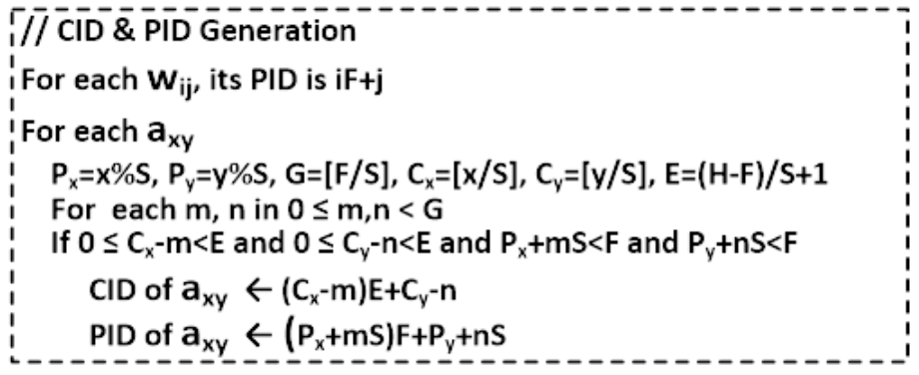
GoSPA: Dataflow
F: Kernel size; H: Activation size; S: Stride

Slide 8
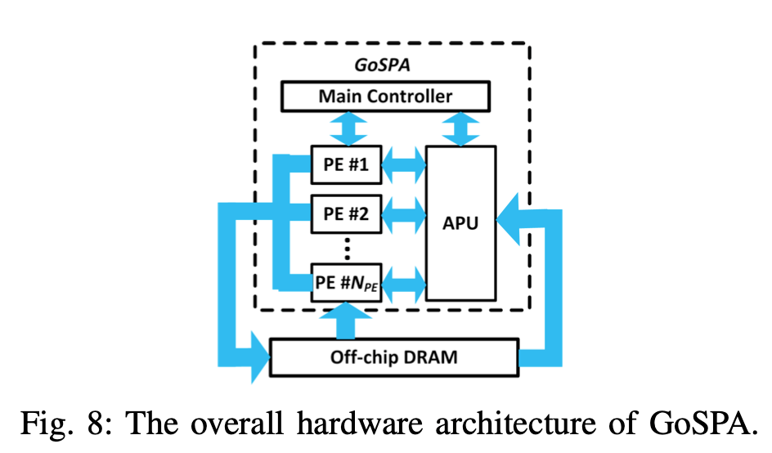
GoSPA: Hardware Architecture
Overall Organization
DRAM: store sparse weight and activations in the form of CSR
APU: Activation Processing Unit, calculates PID and CID for activation
PEs: perform 2D convolution in parallel

Slide 9
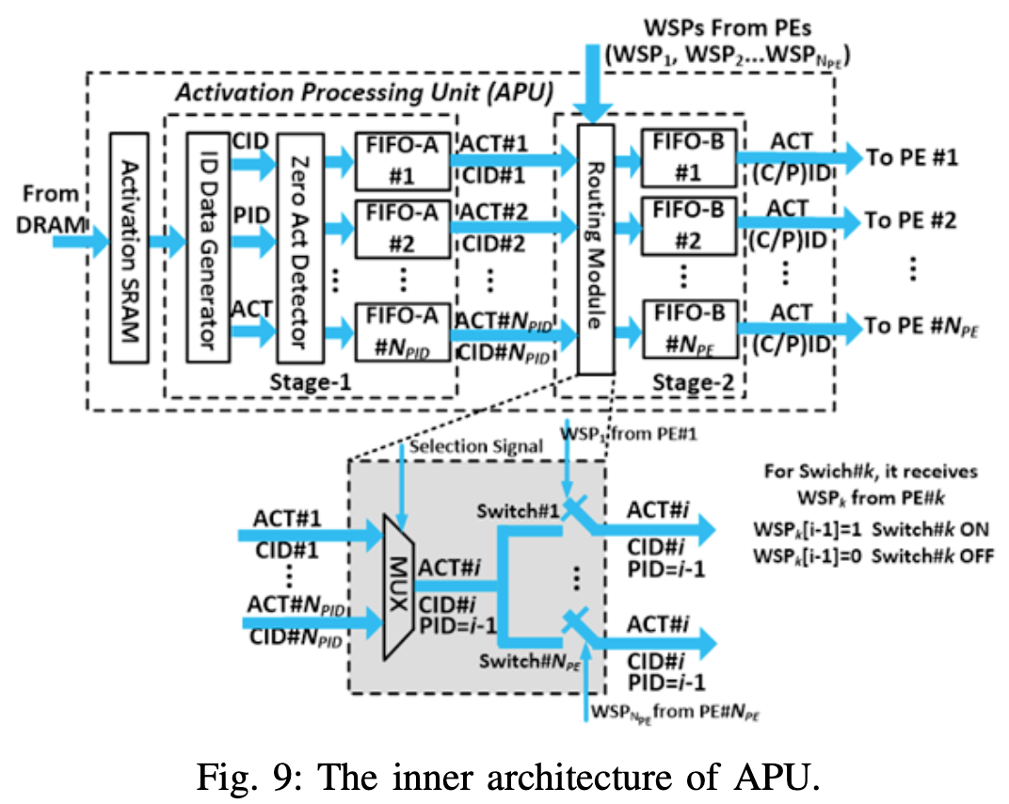
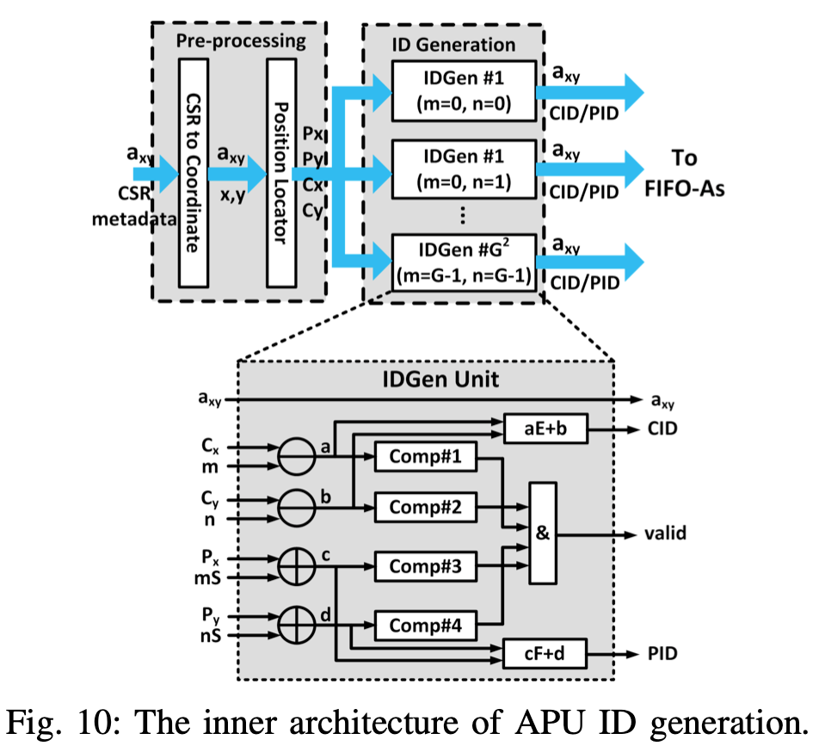
GoSPA: Hardware Architecture
Activation Processing Unit (APU)
Stage1: generates PID and CID, stores the non-zero activation in FIFO A.

Slide 10
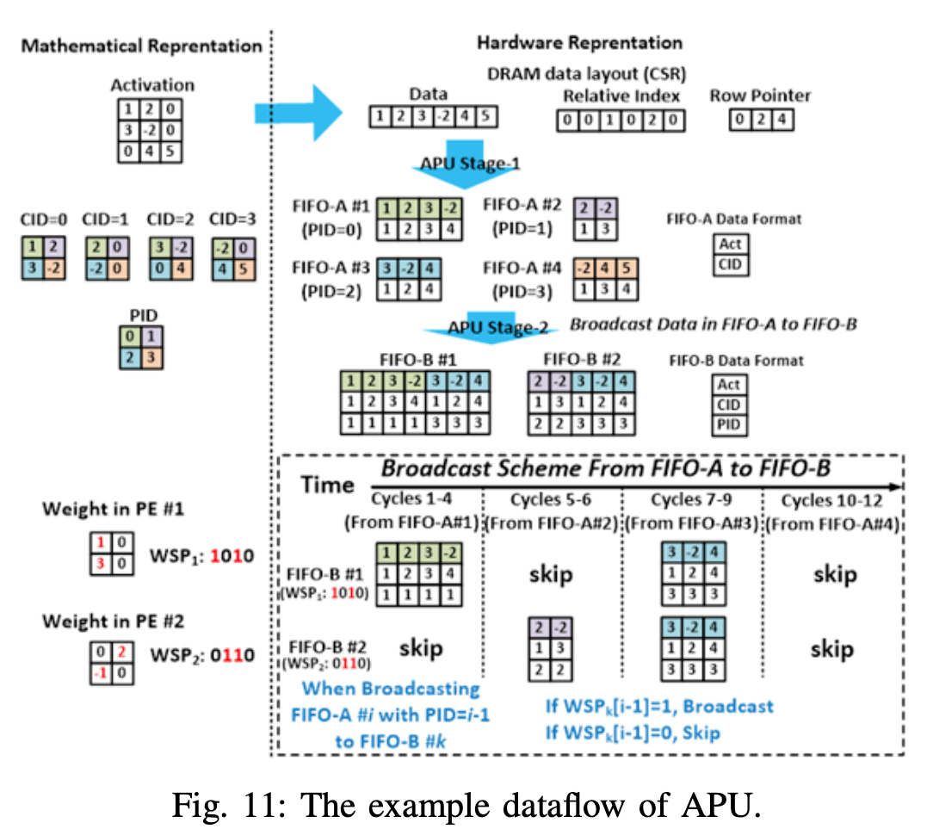
GoSPA: Hardware Architecture
Activation Processing Unit (APU)
Stage2: distinguish the activations paired with the non-zero weights from the activations paired with the zero-valued weights and send it to the PEs

Slide 11
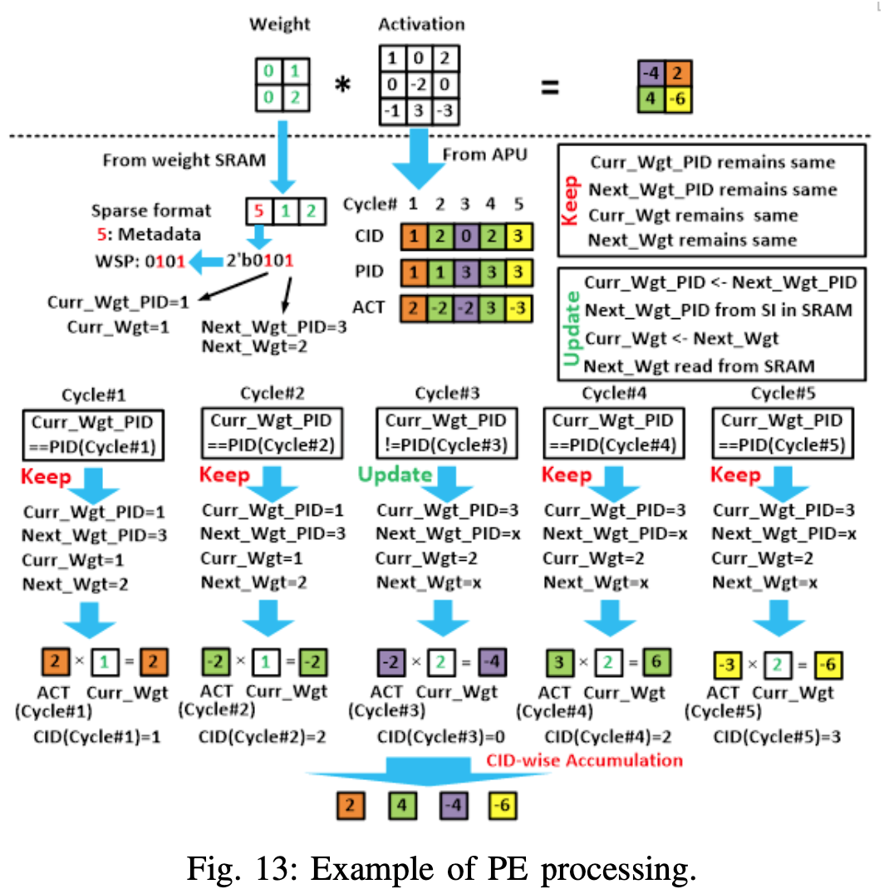
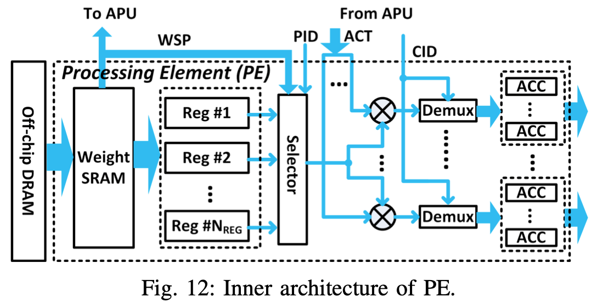
GoSPA: Hardware Architecture
PEs
Nreg: number of weight filter
WSP: weight sparsity pattern

Slide 12
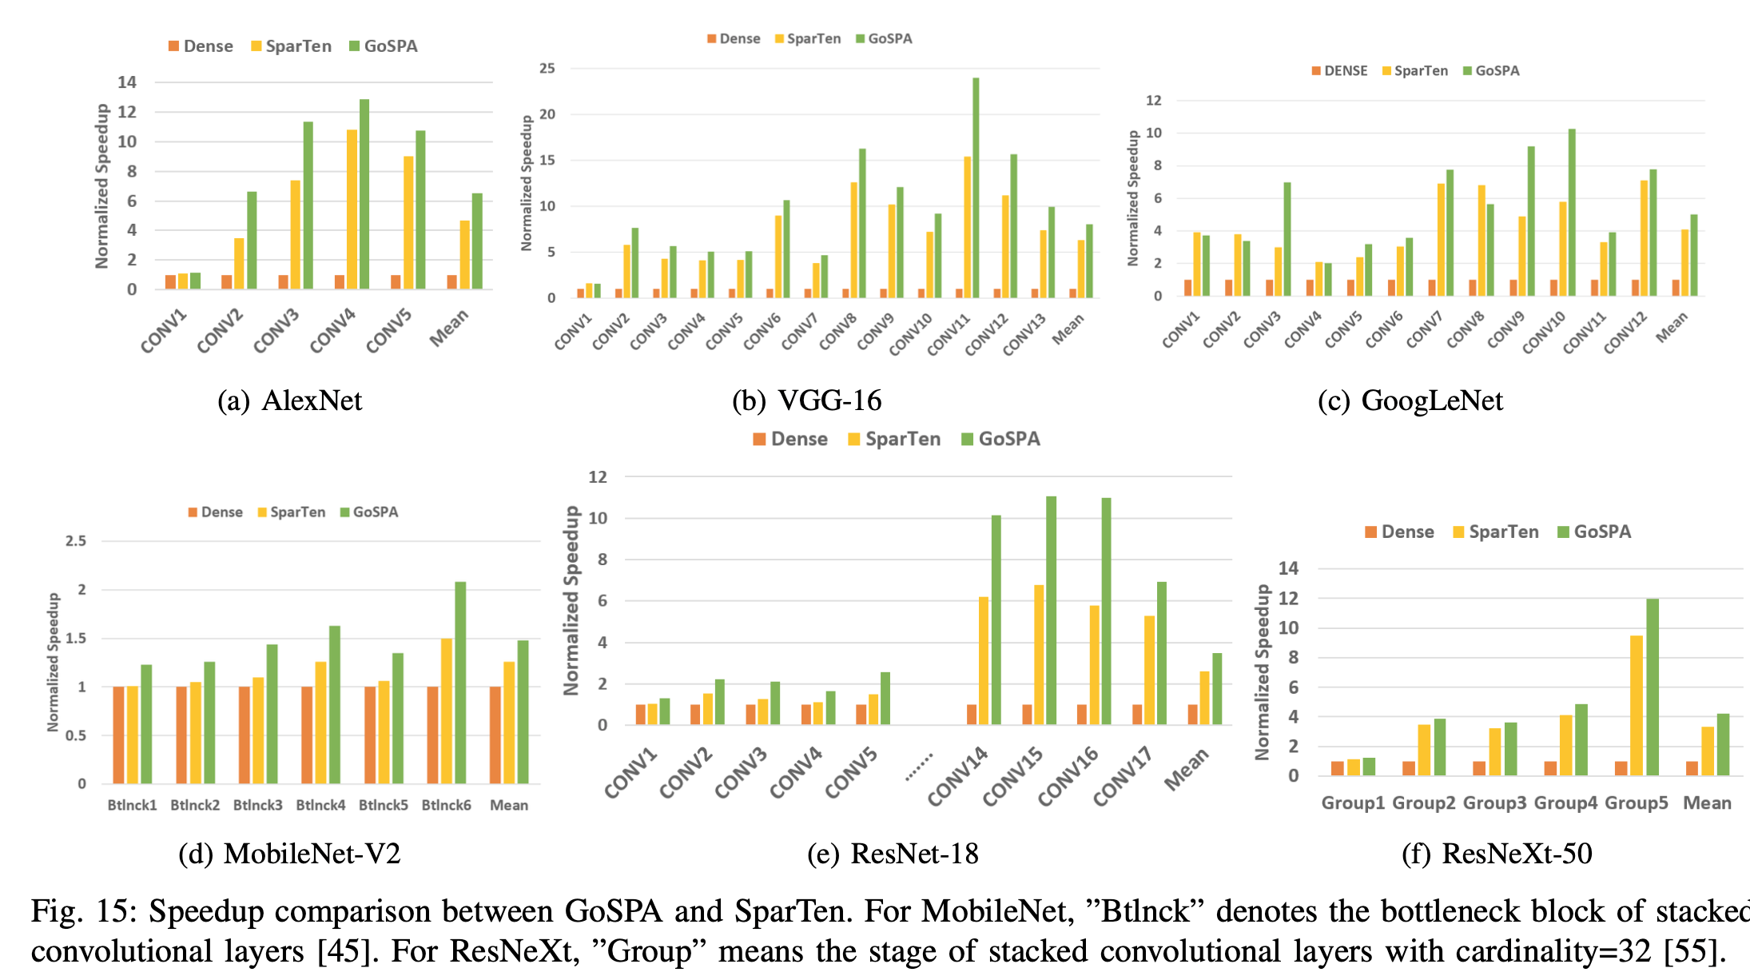
Evaluation
Comparison with SparTen: speedup
GoSPA achieves 1.38×, 1.28×, 1.23×, 1.17×, 1.21× and 1.28× overall speedup across all the layers of AlexNet, VGG, GoogLeNet, MobileNet, ResNet and ResNeXt, respectively.

Slide 13
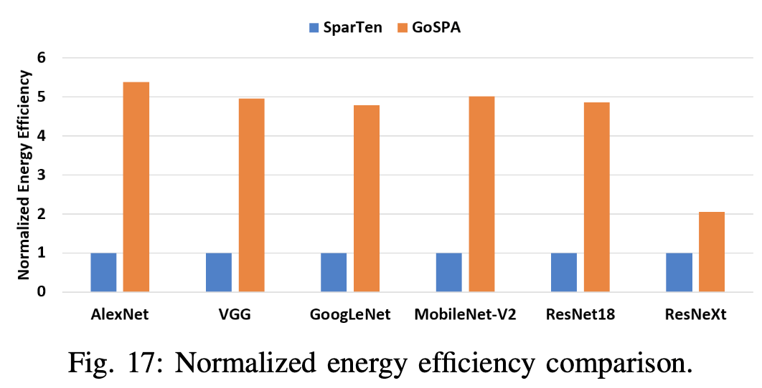
Evaluation
Comparison with SarTen: energy
GoSPA achieves 5.38×, 4.96×, 4.79×, 5.02×, 4.86× and 2.06× higher energy efficiency over SparTen on AlexNet, VGG, GoogLeNet, MobileNet, ResNet and ResNeXt

Slide 14
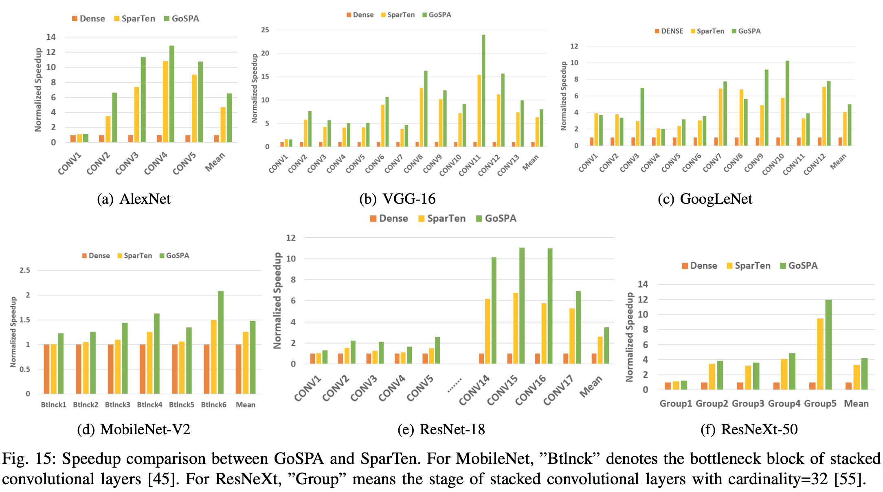
Evaluation
Comparison with SarTen: SRAM access
GoSPA has an average of 5.5×, 6.0×, 3.9×, 6.57×, 5.73× and 2.76× less SRAM access than SparTen on AlexNet, VGG, GoogLeNet, MobileNet, ResNet and ResNeXt, respectively. This is because weight reuse and reordering .

Slide 15
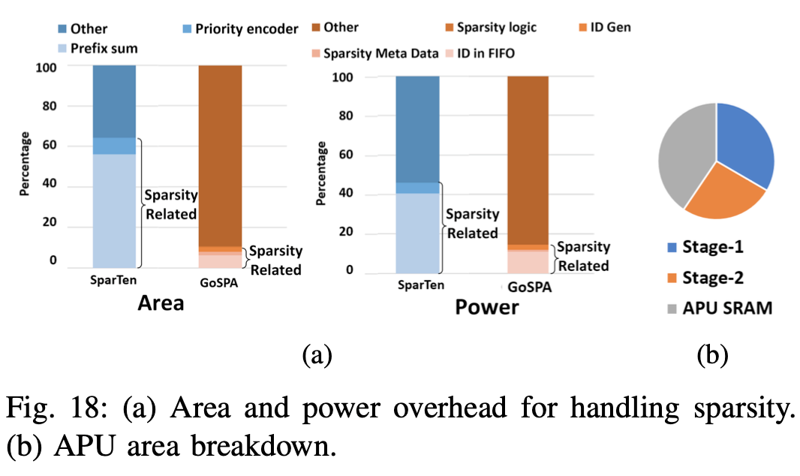
Evaluation
Comparison with SparTen: hardware overhead
It is seen that for SparTen the prefix sum and priority encoder consume 62.7% and 46% of the total area and power; while only 10.6% and 14.5% of the area and power consumption of GoSPA come from modules involved with handling sparsity. Such huge saving on hardware cost further brings better energy efficiency of GoSPA over SparTen.

